Slide 1
Story Maps

Slide 2
Story Maps
All maps tell a story
You can use a single layout and have it show a single thought
Or ESRI came up with the Story Map Builder
It is an easy web map template where you can design a series of maps or show different features on a single map
It is a good option for presentations
Your final Project will be handed in using a Story Map

Slide 3
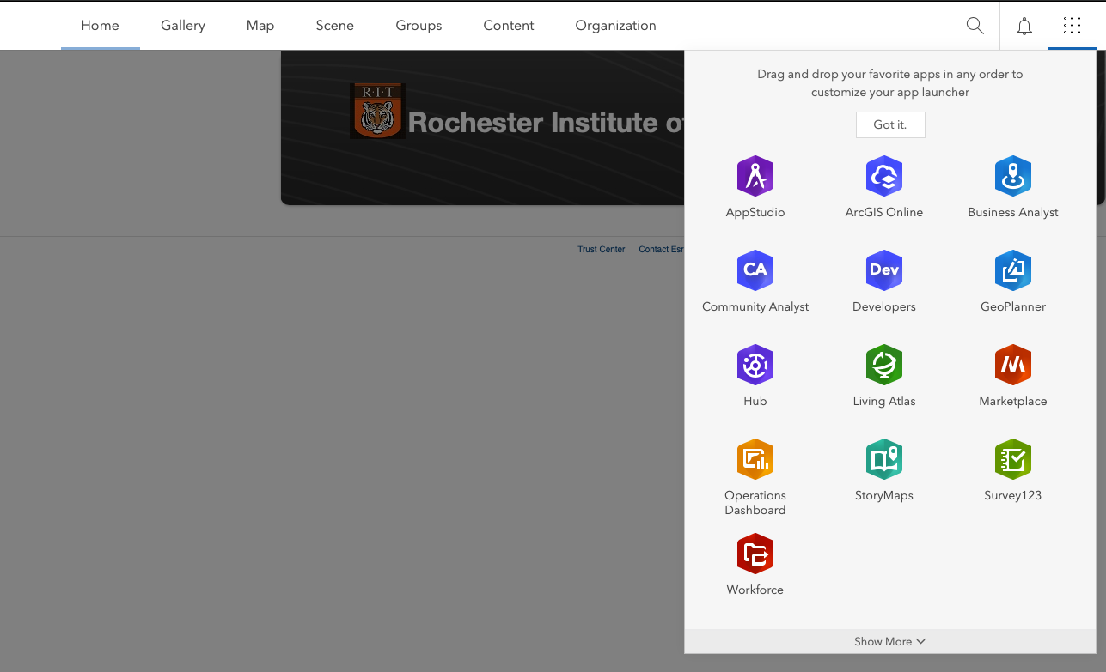
Access Story Maps Using the App Menu in ArcGIS Online

Slide 4
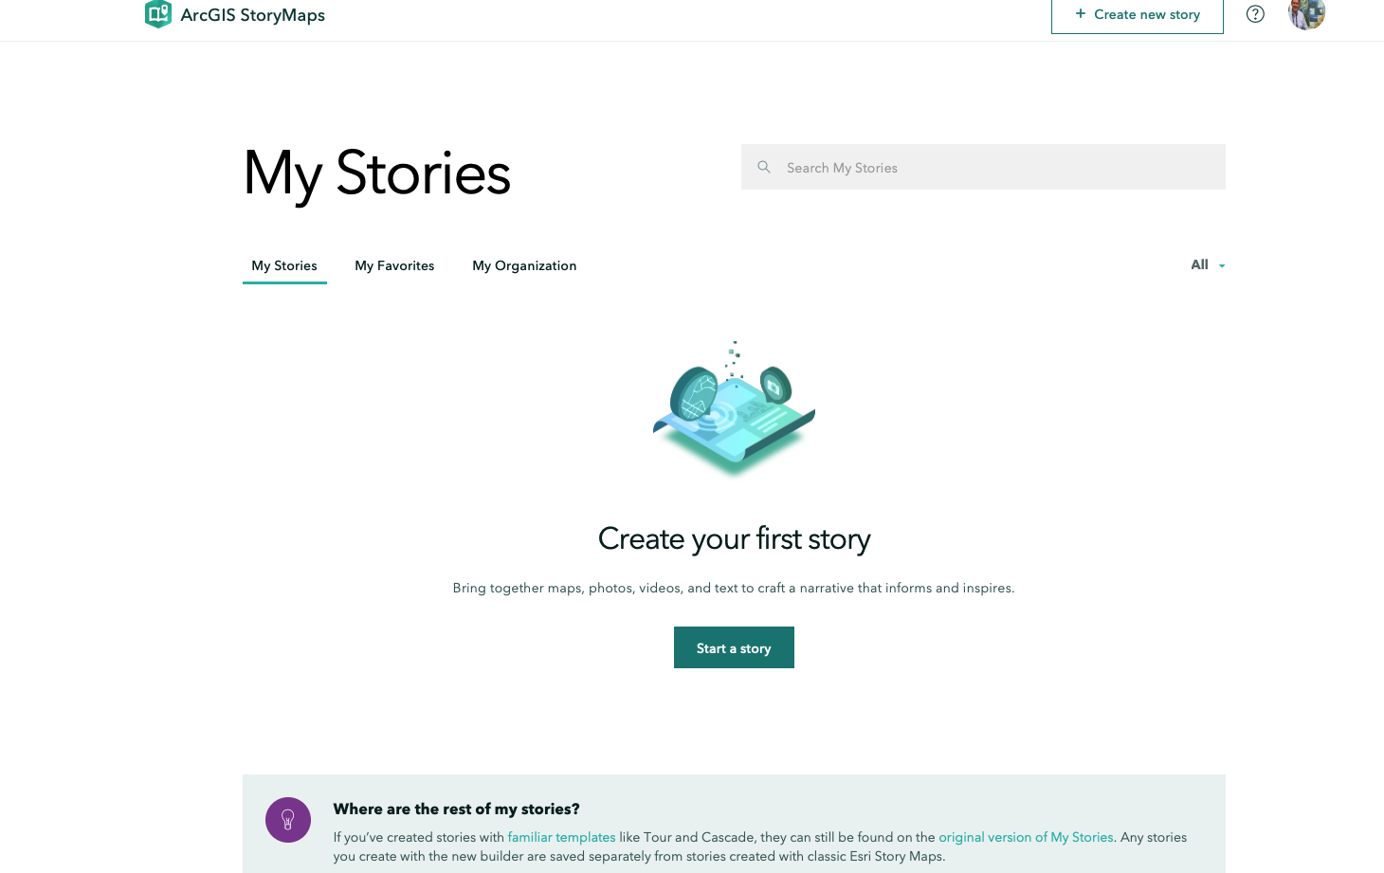
Starting a New Story is Easy

Slide 5
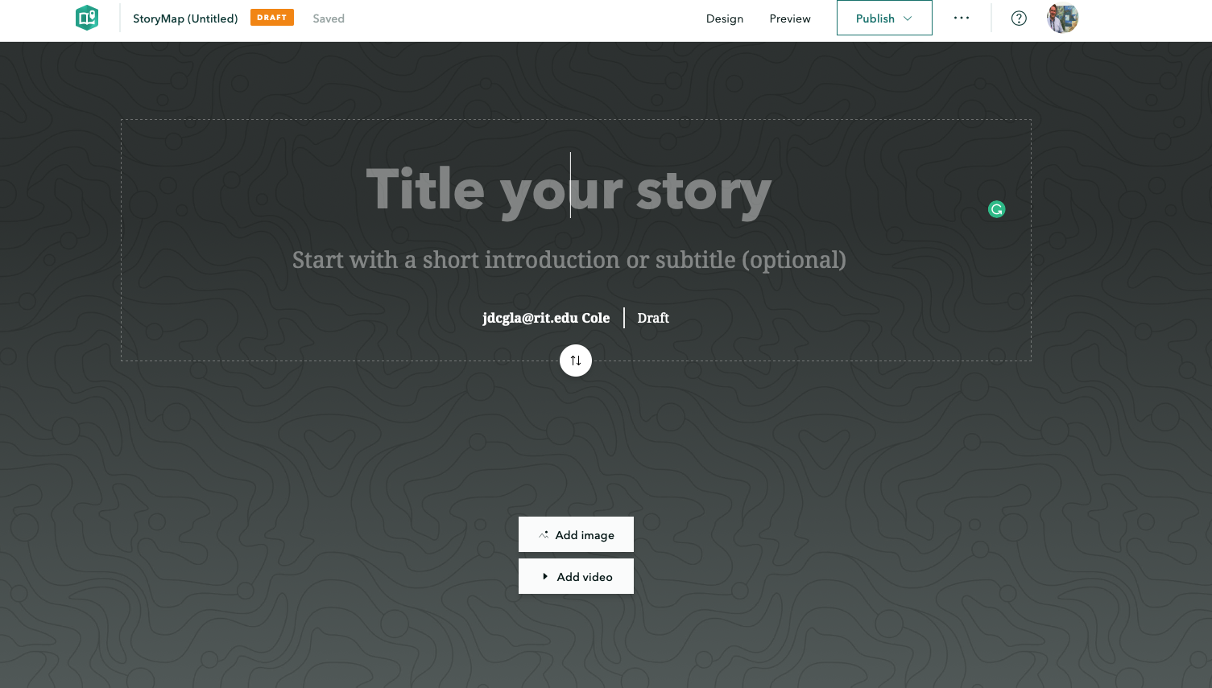
Creating a Storymap is Easy

Slide 6
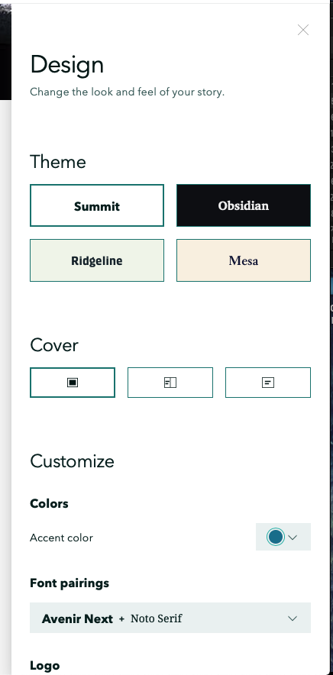
You can also change the Design from the Top Menu

Slide 7
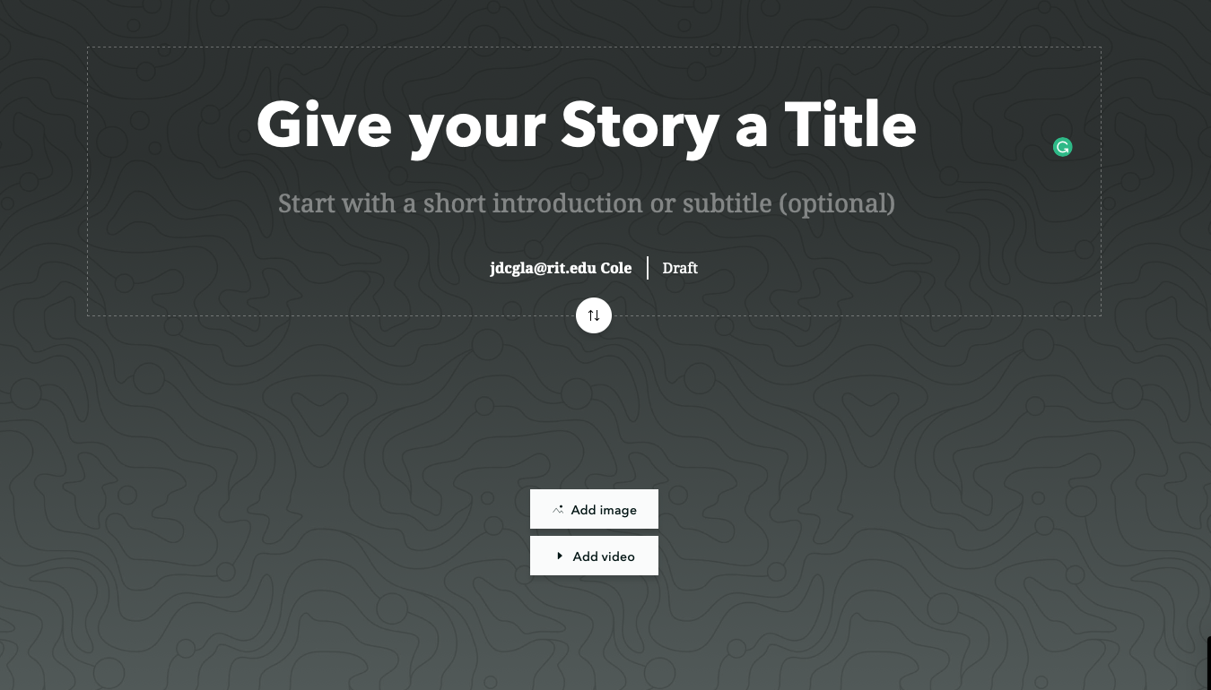
Give it a title

Slide 8
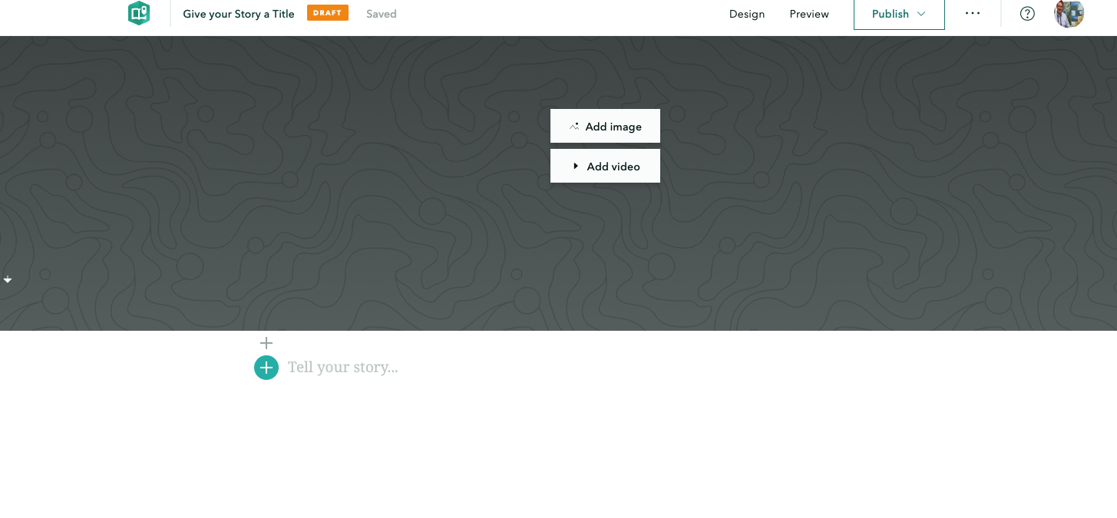
Scroll Down to Add content

Slide 9
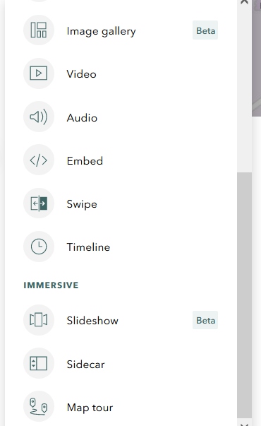
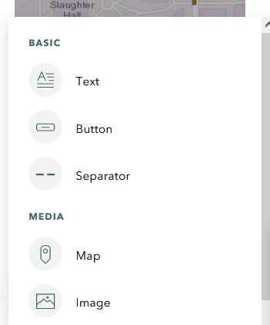
Adding Content

Slide 10
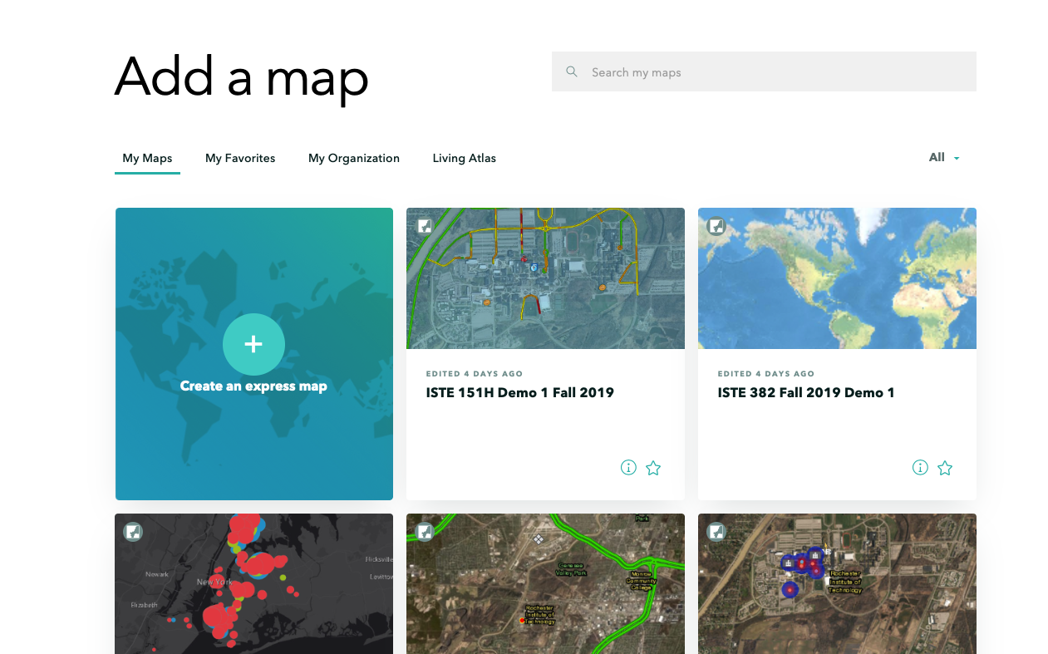
Adding A Map

Slide 11
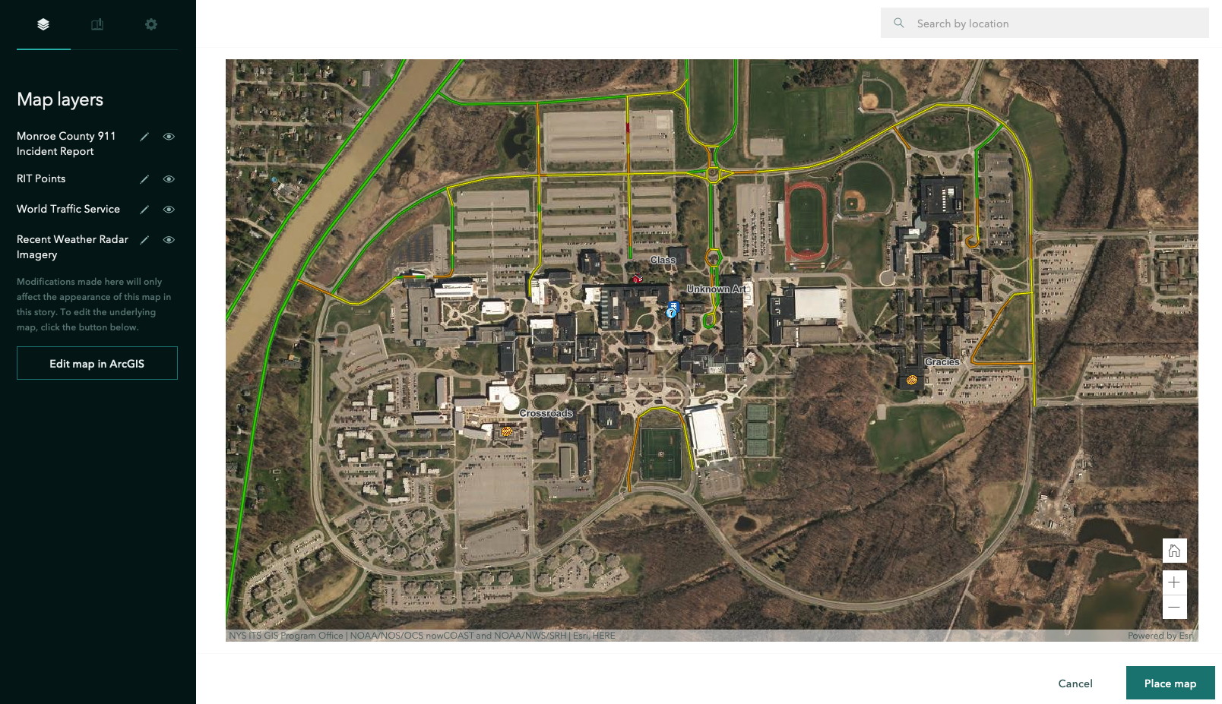
Adding a Map

Slide 12
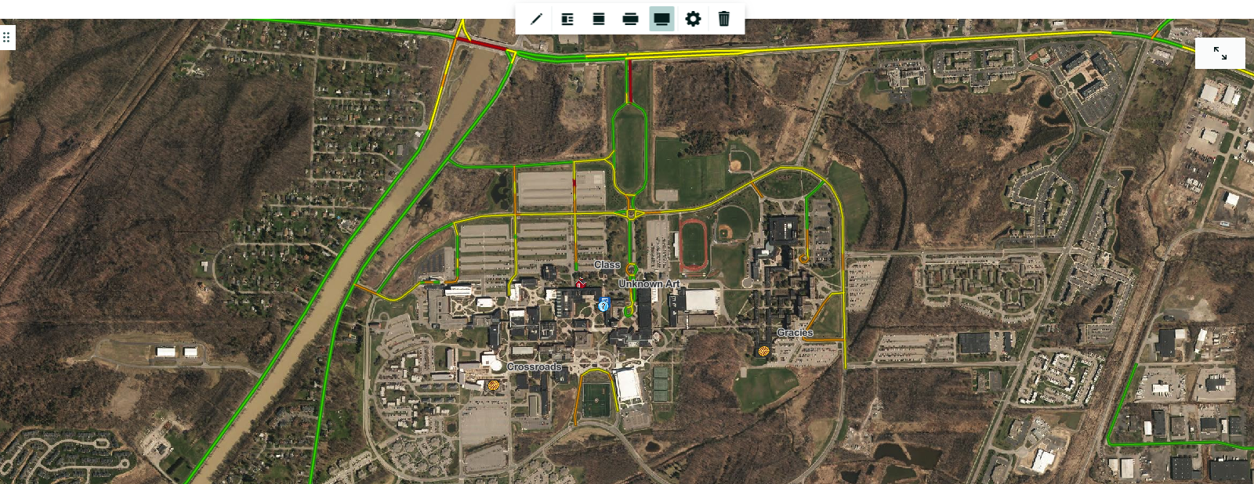
Adding a Map

Slide 13
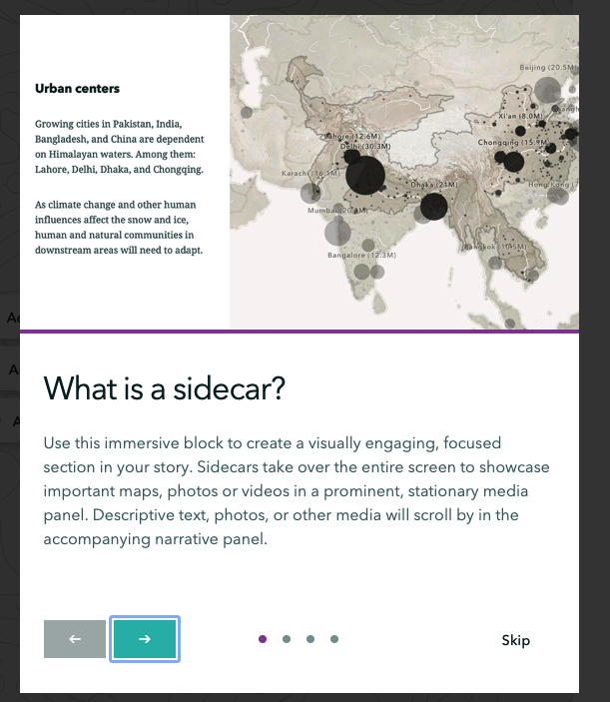
Other Things to Add
(Sidecar)

Slide 14
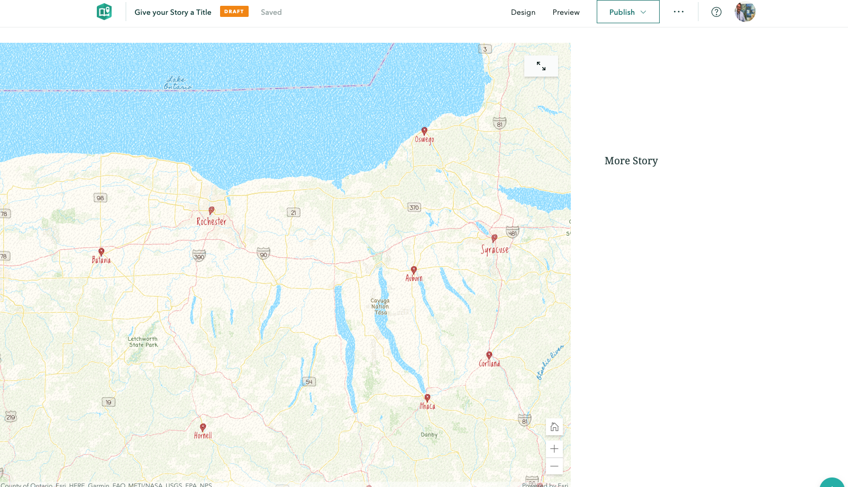
Other Things to Add
(Sidecar)

Slide 15
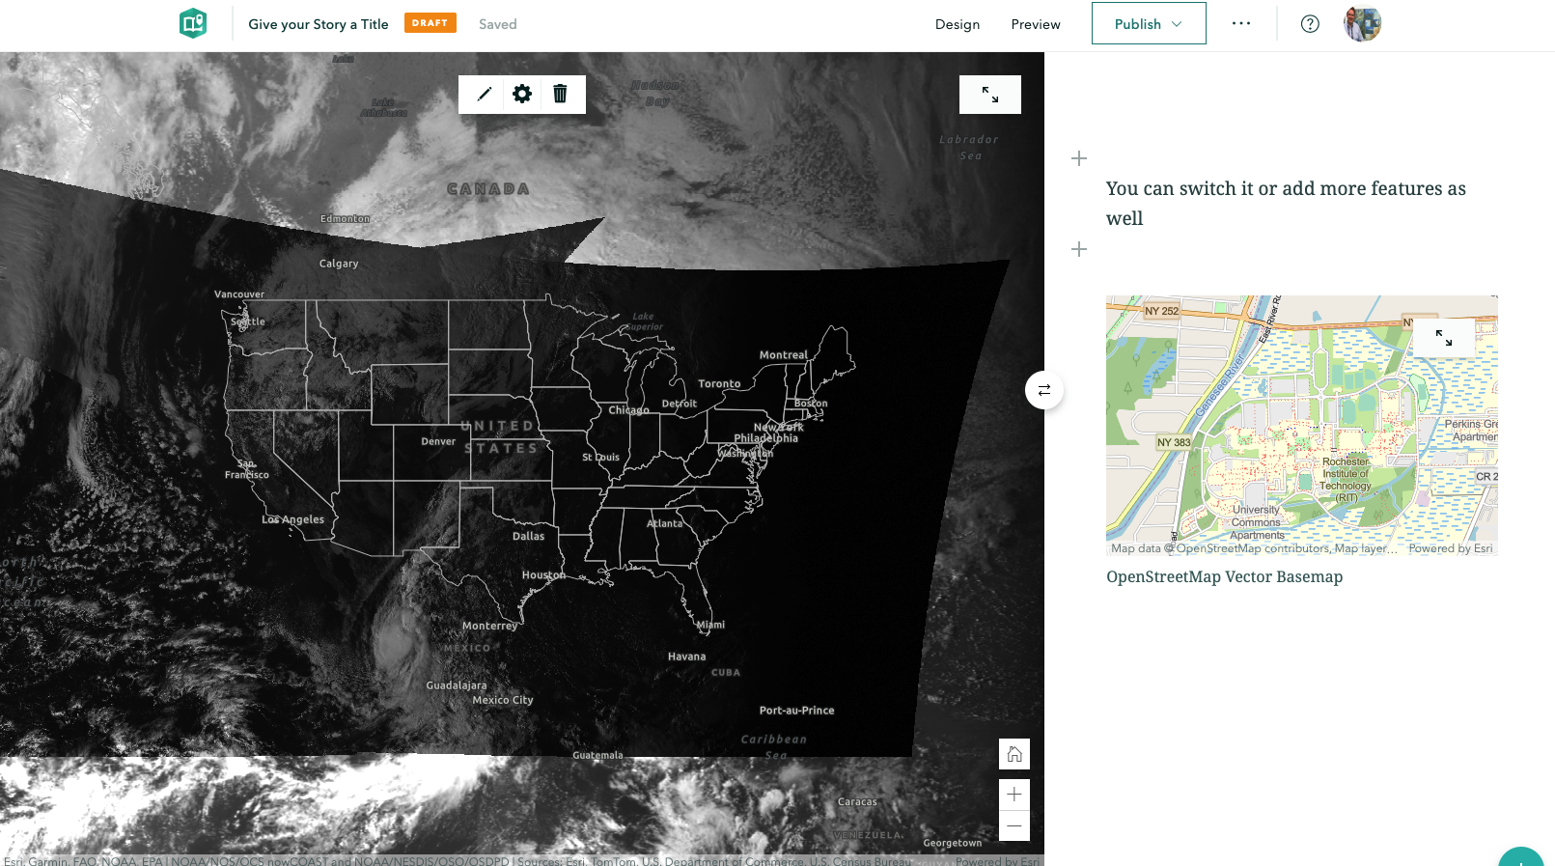
Other Things to Add
(Sidecar)

Slide 16
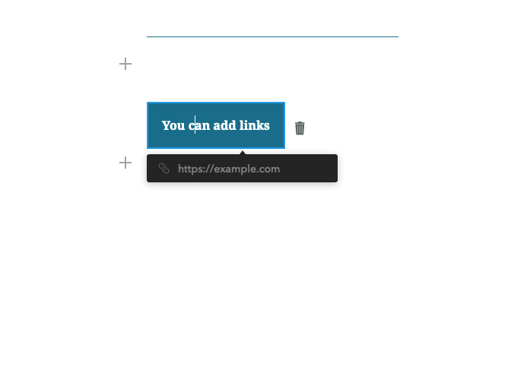
Other Things to Add
(Buttons)

Slide 17
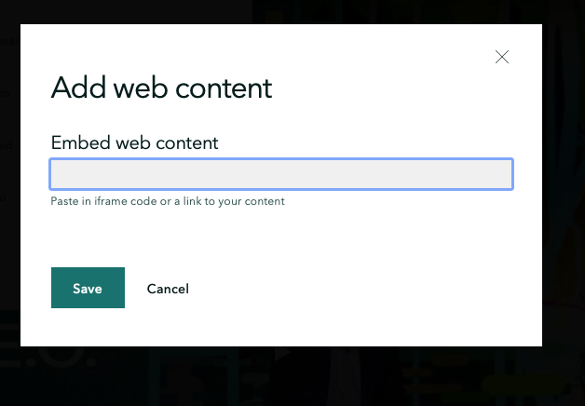
Other Things to Add
(Video)

Slide 18

Other Things to Add
(Video)

Slide 19
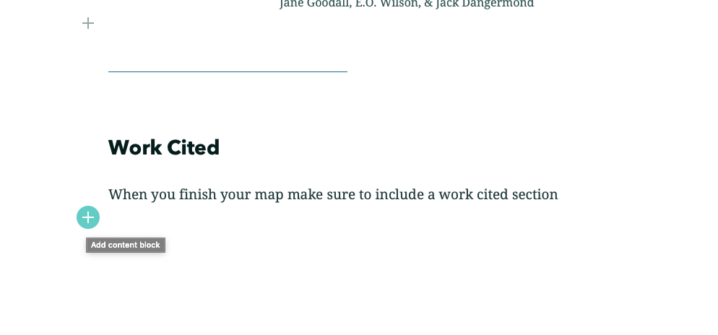
Reminder

Slide 20
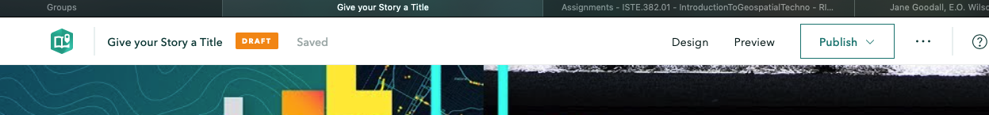
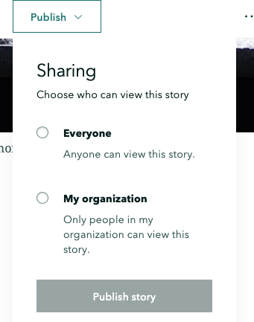
Saving and Sharing
When you publish the storymap you will be given a URL and a QR code

Slide 21
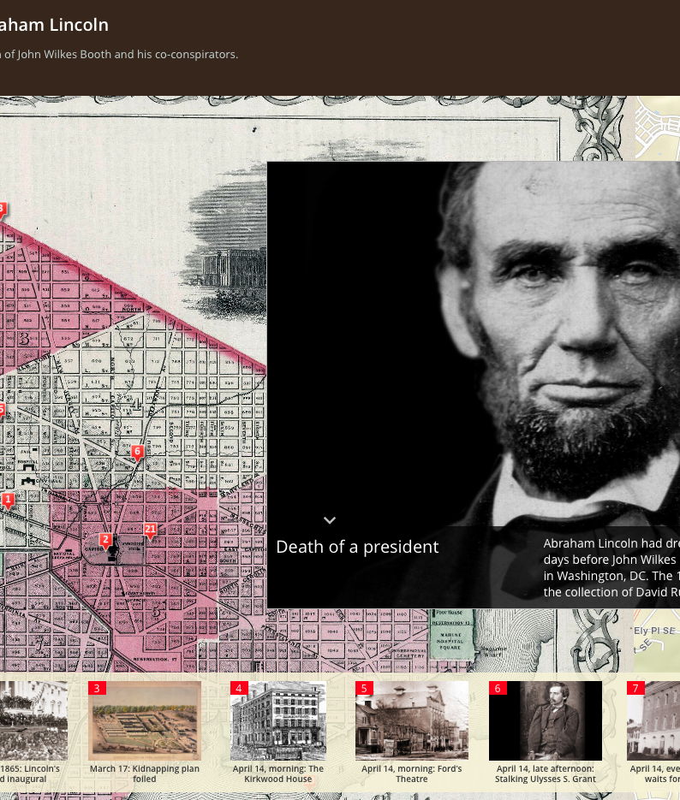
Story Maps
Examples
https://storymaps.esri.com/stories/terrorist-attacks/?year=2017
https://arcgis-content.maps.arcgis.com/apps/Cascade/index.html?appid=706bd93eaef143898c3d0c49e8a5940d
http://story.maps.arcgis.com/apps/StorytellingSwipe/index.html?appid=459ff1719f5f427180cd8b793894052b&webmap=7076dcc3049c44c68ef7afc36b754e87
http://storymaps.esri.com/stories/2013/gettysburg/

